Slide 1





Low Dead Space Needles & Syringes (LDSS/N)
Training for community researchers and peer educators
In support of Unitaid HCV Portfolio Projects on Hepatitis C and People who Inject Drugs in LMIC

Slide 2
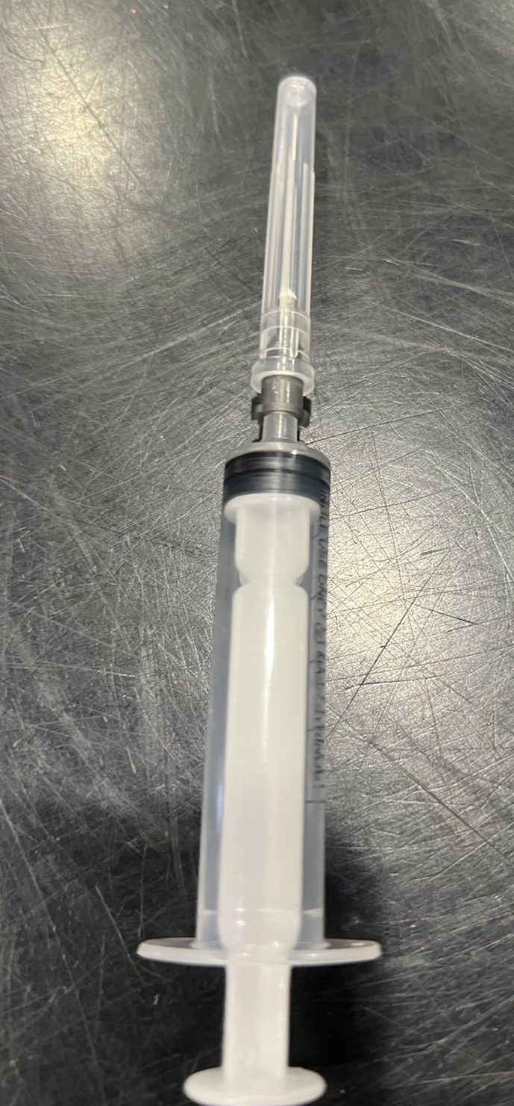
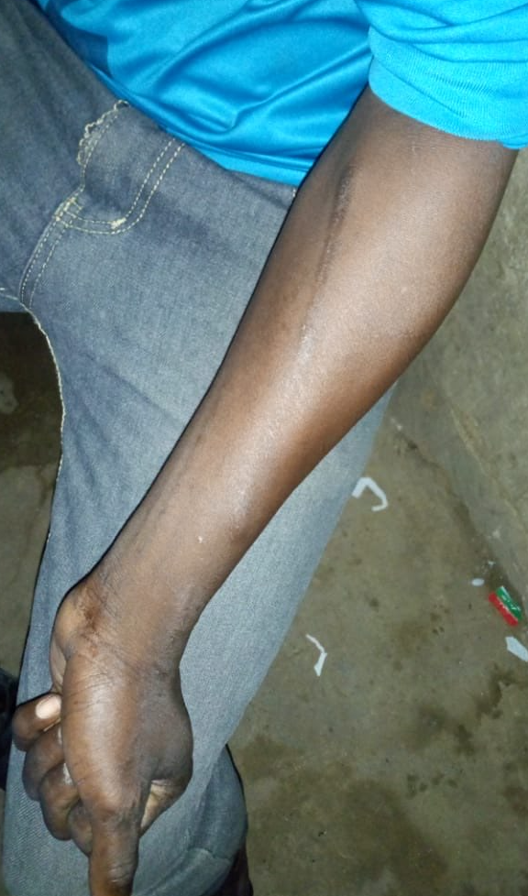
FGD Presentation
Oversize Needles and Syringes
There are many reasons why oversized N&S might be used by people who inject drugs:
Lack of access to NSP – forced to use N&S from hospital/clinics that are made for medical purposes.
Purchasing/procurement practices – not consulting people who inject drugs on their preferences resulting in the ‘wrong’ equipment.
‘Cold Shake Method’ – putting the drug in the back of a syringe and mix it by drawing up blood, water or other solution and shaking – requires larger barrel.
Brown heroin that is not “cooked up”, sterilized or filtered will not go through a finer insulin combination needle and syringe.
Single use/auto disable needles are syringes – NOT suitable for or preferred by people who inject drugs.
Notes:
Training Facilitator Notes:
Slides 33 – 37 are provided as a brief information session to educate community researchers/facilitators and note takers who will be conducting the FGD about LDSS/N as part of their FGD training. It can also be separated from this deck and used as a stand-alone slide deck in the FGD (in addition to or instead of the video resource – see slide 30 above) to educate participants on LDSS/N – why PWID might use HDS equipment, what dead space is, differences between HDS, LDS and RDS and the potential benefits of using LDSS/N). Using these slides and the video resource will also increase the likelihood of consistency in the quality of the information provided on LDSS/N in the FGD.

Slide 3
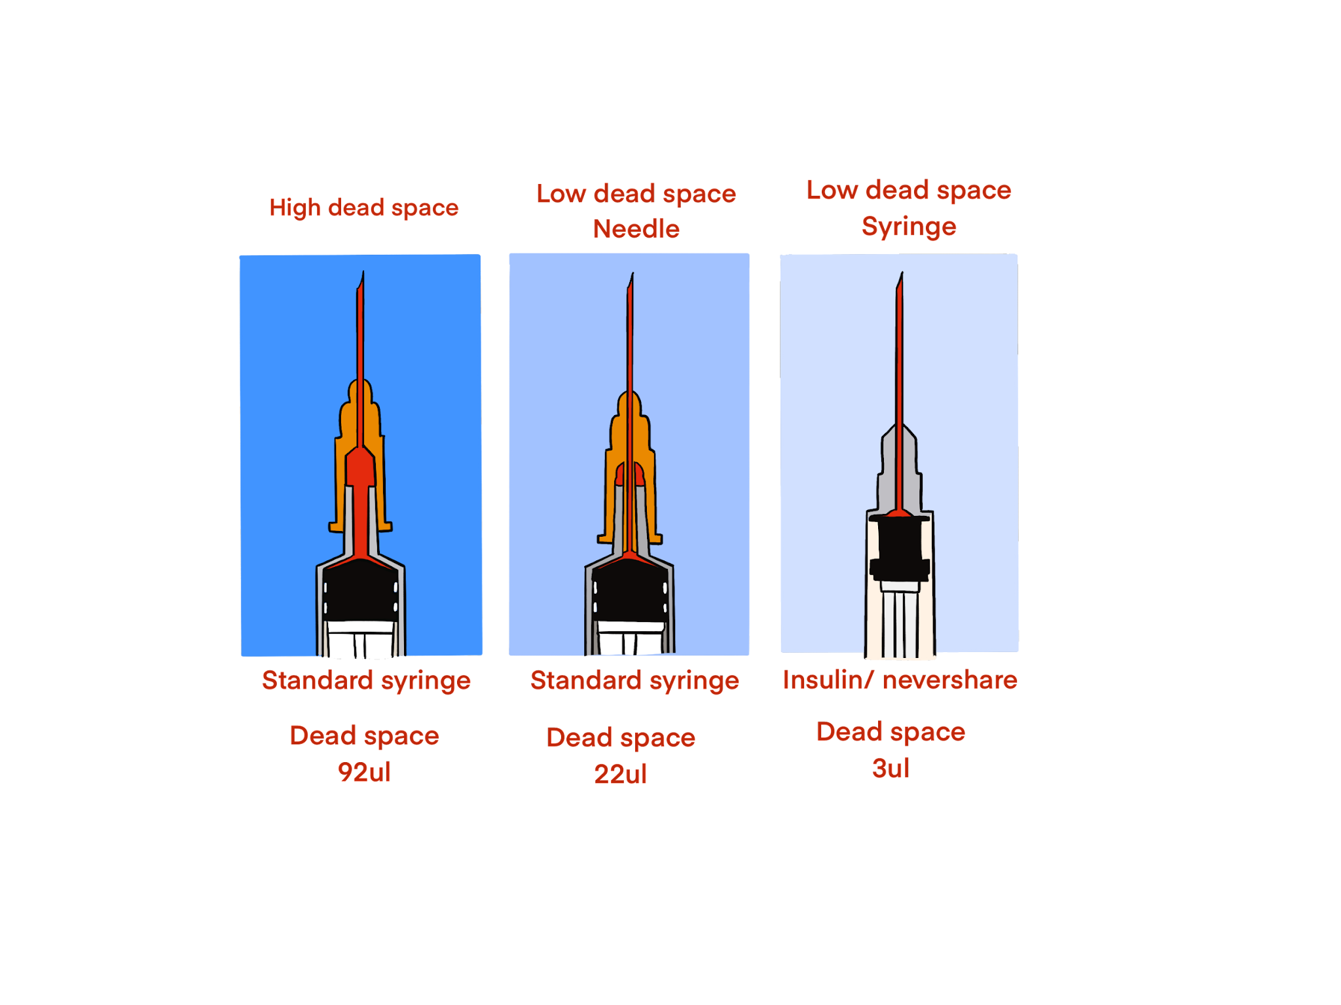
FGD Presentation
What is Dead Space?
What is Dead Space?
Dead space is the space between the needle and the plunger when the plunger is pressed all the way down to the end of the syringe. This is the space where blood remains after the needle and syringe has been used.
Why is the amount of dead-space important?
Some needles and syringes have more dead space than others and this can mean that more blood and drug is left behind after injecting. This blood could contain viruses like HIV, hepatitis C or hepatitis B. The lower the dead space, the less blood left behind and the lower the risk of getting or passing on viruses if the needle & syringe is reused.

Slide 4
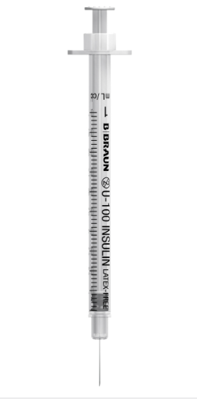
FGD Presentation
High & Low Dead Space Syringes
High Dead Space Syringes/Needles
Needles and syringes (that come as a separate syringe and detachable needle) are high dead space – a larger amount of bloody drug solution is left inside the needle and syringe after injection (after the plunger is fully depressed).
Low Dead Space Syringes
Standard insulin-type 1ml fixed needle and syringe units and other fixed needle and syringes are naturally low dead space – there is very little room for any bloody drug solution after injection (after the plunger is fully depressed).
High Dead Space Syringe with separate Needle
Low Dead Space ‘Fixed’ Syringe/Needle Unit

Slide 5
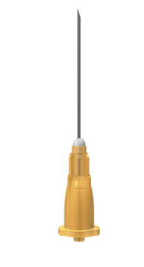
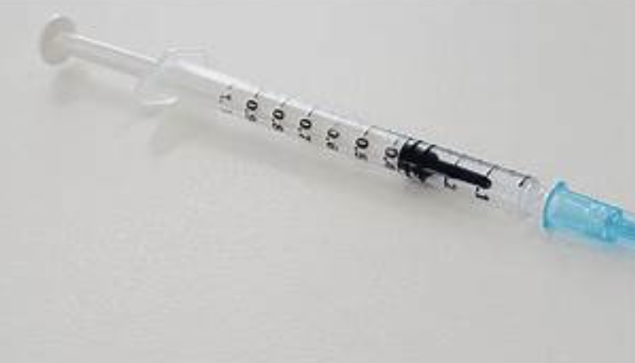
FGD Presentation
Other Types of Needles & Syringes
Low Dead Space Needles
A1ml fixed LDSS doesn’t suit everyone’s needs
Low dead space needles have a plastic spike that fills the dead space between the end of the plunger and the tip of the syringe
Comes in different gauges/sizes (21G, 23G, 25G, 30G).
Fits any High Dead Space Syringe (HDSS).
Dead Space = not as low as 1ml LDSS (fixed insulin = 3ul) but 9 – 13ul (approx. 85 - 90% less than standard HDS)
Reduced Dead Space Syringes
The rubber tip of the plunger is extended using a spike that extends into the tip of the syringe and partially fills the dead space (see image below).
Come in 2.5ml and can be used with standard high dead space needles (but cannot be used with low dead space needles).
Dead Space = 45ul (approx. 50% less than standard HDS which = 92-99ul )
Low Dead Space Needle
Reduced Dead Space Syringe

